Slide 1
Functions
Session 6

Slide 2
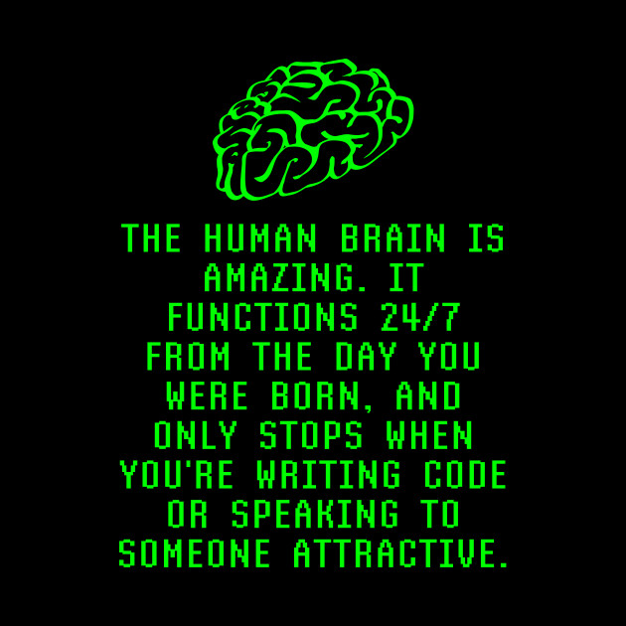

Slide 3
Tính tổng các số nguyên tố từ 1 đến N?

Slide 4
Functions
Library Functions

Slide 5
Name, Return Value, Argument
function – named group of statements carrying out a particular task that accepts values and computes the result
  function name – identifier distinguishing the function from others
    example – square root function: sqrt
  argument – the value accepted by the function to use in computation
  return value - value computed by the function
function accepts arguments of certain type and returns the value of certain type
  sqrt accepts and returns double
C++ comes with libraries of code that can be reused in your programs. The code comes in the form of pre-defined functions
  what is the program that adds pre-defined functions to your code to produce executable?
  sqrt is a predefined function
to use a function, need to specify particular include directive:
  to use sqrt #include <cmath>

Slide 6
Invocation, Argument Variants
function call (function invocation) – executing function code from elsewhere in program
  syntax: expression consisting of function name followed by arguments in parentheses
  result = sqrt(9.0);
  semantics: argument is evaluated, function is executed, return value replaces function invocation
invocation forms
  in expression – return value replaces invocation in expression evaluation
    result = sqrt(9.0) – myVar*5;
  standalone – return value is ignored
    srand(55);
argument variants
  function may have more than one argument
    result = pow(myVar, 55);
  an argument is an (arbitrary) expression
    result = sqrt(myVar*2 + 9.0);
  nested function call: use of one function call as argument to another
    result = sqrt(abs(myVar));

Slide 7
Functions
User-Defined Functions

Slide 8
Function Invocation Semantics
argument
cout << add1(4+5)+6 << endl;
invocation
caller – function that invokes another
callee – function that is being invoked
processing a function invocation: caller is suspended, callee is executed, callee computes the return value which substitutes invocation in the caller
  if invocation is inside an expression, the return value is used to evaluate the expression

Slide 9
Function Definition
function definition – specifies instructions that the function executes
consists of head, body
return type
function name
parameter
double circleArea (double r) {
const double pi = 3.1415;
return pi * r * r;
}
function head
function body
return statement

Slide 10
Parameters and return-statement
programmer defined function cannot know what arguments will be passed to it; it uses (formal) parameters
parameters - local variables of the callee that are initialized to the value of arguments at invocation
return-statement specifies what value the function returns:
  syntax: return expression;
  the expression is evaluated, coerced to the type specified in function head, terminates function
  a return-statement is optional. If a function does not have a return-statement it terminates when the last statement is executed. The return- value is unspecified
  it is possible to have multiple return-statements. However, putting a return someplace deep in function code is bad style. Try to code a single return or obvious returns.

Slide 11
Function Prototype
function prototype – declares (quickly introduces) the function
  returnValue functionName(type parameterName,…,);
  expanded form – mentions parameter types and names: names are optional but sometimes desirable for clarity
    int add1(int i);
  abbreviated form – mentions only parameter types
    int add1(int);
before function invocation, the compiler needs to see either its definition or prototype
unlike variables, the function definitions and function prototypes should be put outside any other function: no nested functions in C++ standard
it is (almost) possible to write a program without prototypes: put function definitions before invocations
  such program is hard to understand: more detailed functions would be ahead in file
  better program style - put function prototypes first, then main(), then other functions with increasing level of detail

Slide 12
Commenting Functions
treat a function prototype as a variable definition: append a short inline description of the function
precede a function definition with at least one line of comments explaining the purpose of the function, possibly comment on parameters

Slide 13
Function Terms Quick Review
what are the terms for the constructs in gray boxes?
double circleArea(double r); // computes circle area
// manage circle computation
int main() {
cout << "Enter radius: ";
double radius; // circle radius
cin >> radius;
const double area = circleArea(radius);
cout << "Circle has area " << area << endl;
}
// computes area of radius r circle
double circleArea(double r) {
const double pi = 3.1415;
return pi * r * r;
}

Slide 14
Simple Program Structure
include statements
using statements
function prototypes
function definitions
  main()
  rest with increasing order of detail

Slide 15
Local Variables
variable that is declared inside a function is local (to that function): it cannot be used outside of the function
the scope of such variable is from declaration till end of function
parameters are also local variables
local variables of two different functions are different even if they have the same name
variables declared in main() are local to main()
example
  // computes sum of integers in a..b
  int sum(int a, int b) { // a and b are local
  int total = 0; // this is a local variable
  for (int i = a; i <= b; ++i) { // i is local to for
  total += i;
  }
  return total;
  }

Slide 16
Global Constants and Variables
constant or variable declared inside a function is local to this function
global constant – a constant declared outside any function definition
  it can be used (its scope is) anywhere in the program from the place it is declared
global variable – variable declared outside any function definition
  int errorcode = 0;
  global variable scope is any function of the program from variable declaration down, functions can read and update global variable
  using global variables introduces side effects to functions
    what's "side effect" gain?
    makes program hard to understand: avoid!

Slide 17
Call-by-Value
parameters are local variables of the function
when the function is called, the values of the arguments are evaluated and assigned to respective parameters
as any local variable, the value of a parameter can be changed in a function
this change does not affect the values of the original arguments
such discipline of parameter passing is call-by-value
int add1(int i) {
  ++i;
  return i;
  }
  ...
  int n=5;
  int newn = add1(n); // value of n is unchanged

Slide 18
Functions
Void Functions, Predicates
Program Stack, Call-by-Reference

Slide 19
Void Functions
void function – does not return a value, can only be used as a standalone statement
void is specified as return type
return-statement is not necessary; if used, cannot contain expression
output functions are often void-functions:
  void showResults(double fard, double celd){
  cout << fard
  << ” degrees Fahrenheit is equivalent to ”
  << celd
  << ” degrees Celsius.\n”;
  return; // not necessary
  }

Slide 20
Predicates
predicate – function whose return value is boolean
used to compute a binary decision
idiom: use a predicate as an expression in a looping or branching construct
bool again(){
cout << "Again? [y/n] ";
char answer;
cin >> answer;
if (answer == 'y')
return true;
else
return false;
}
  int main(){
  do
  cout << "Hello, World!\n";
  while(again());
  }
how do you code looping construct so that it continues if boolean function
returns false rather than true?
how do you shorten code for again()?

Slide 21
Program Stack
variable memory allocation – assigning memory location to a variable
program (call) stack – means of memory allocation to local function variables during program execution
  last-in/first-out (LIFO) data structure
function frame – unit of call stack allocation
  contains local variables, parameters, return value
  active frame – frame of
  currently executing function
  inactive frame – others on stack

Slide 22
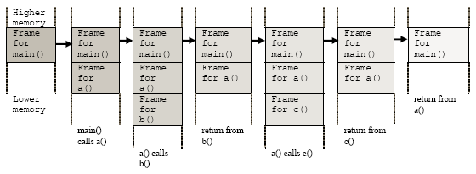
Allocating Frames on Stack
int main(){
a();
}
void a(){
b();
c();
}
  void b(){
  ; // does not do anything
  }
  void c(){
  ; // does not do anything
  }

Slide 23
Call-by-Reference
what is call-by-value again?
call-by-reference – parameter passing discipline that allows the function to modify the arguments
it assigns parameter the same memory location as argument
  modification of parameter affects the argument
to distinguish call-by-reference ampersand (&) precedes parameter declaration both in function head and in function prototype
  function call is (almost) indistinguishable
  ampersand may be next to type int& num1 or
  next to variable name int &num1
  where to put: stylistic issue
prototype
  void getNumbers(int &num1, int &num2); // extended form
  void getNumbers(int&, int&); // abbreviated form
definition
  void getNumbers(int &num1, int &num2){
  cout << ”Input two numbers”;
  cin >> num1 >> num2;
  }

Slide 24
Call-by-Reference Example
this function swaps the values of arguments
  void swap (int& left, int& right){
  const int temp = left;
  left = right;
  right = temp;
  }
what is output when this code is executed?
  int i=1, j=2;
  swap(i,j);
  cout << i << ’ ’ << j;

Slide 25
More on Call-by-Reference
function invocations for call-by-reference and call-by-value are similar but not the same:
  double temp;
getInput(temp);
only variables may be passed by reference
  in call-by-reference, the function operates on the memory location of the argument: argument needs to be a variable
  passing constants or expressions by reference is not allowed
  getInput(23.0); getInput(temp + 5); // WRONG!
mixing call be value and reference is allowed: myfunc(int&, double, int&);
functions that need to return more than one value usually use call-by-reference:
  prototype: void getNumbers(int& input1, int& input2);
  call: getNumbers(one, two);
passing one similar value as return and the other as parameter is bad style:
  prototype: int getNumbers(int& input2); // BAD
  call: one=getNumbers(two); // STYLE

Slide 26
Functions
Recursion

Slide 27
Yes, you’re right. It’s your homework! ☺
  What is recursion
  Recursion Example
  Why using Recursion
  How Recursion Works
  Recursion vs. Iteration/Loop

